Slide 1

WIPRO NGA Program – SDET – Batch No: 1
Capstone Project Presentation – 6th and 9th Sept 2024
Project Title Here – Automated Testing of MakeMyTrip.com
Presented by –Tummuri Geetha Vijayanjali
www.rpsconsulting.in

Slide 2

Content
Introduction
Objective
About Application
Manual Testing
Jira
Selenium BDD With Cucumber
API Testing
Approach
Defects Found
Challenges and Overcome
Conclusion
2024 - RPS Consulting all rights reserved

Slide 3
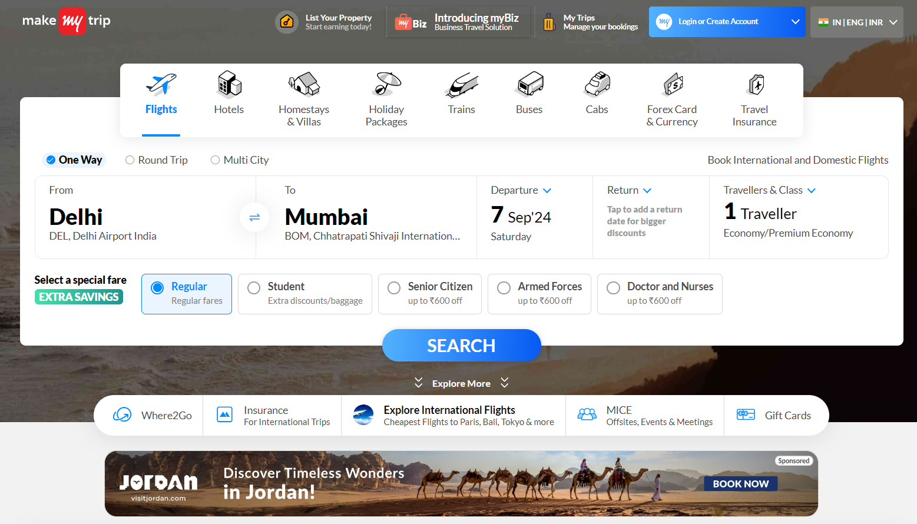
Introduction
Title: Automation Testing of MakeMyTrip website.
What is MakeMyTrip website?
provides online travel services including airline tickets, domestic and international holiday packages, hotel reservations, rail and bus tickets.
2024 - RPS Consulting all rights reserved

Slide 4
Objective
The Objective of this project was to gain hands-on, real-world experience in testing an application, covering end-to-end testing, defect identification, and automation of testcases. This comprehensive approach enhanced my understanding of both manual and automated testing methodologies. It allows me to systematically evaluated the application functionality, from user interactions to ensuring that all components worked seamlessly.
This approach depends my expertise in both manual and automated testing methodologies, equipping me with the skills to design and implement effective testing. Ultimately this project helped sharpen my technical skills while fostering an analytical mindset, essential for delivering high quality software and enhancing overall system performance.
2024 - RPS Consulting all rights reserved

Slide 5
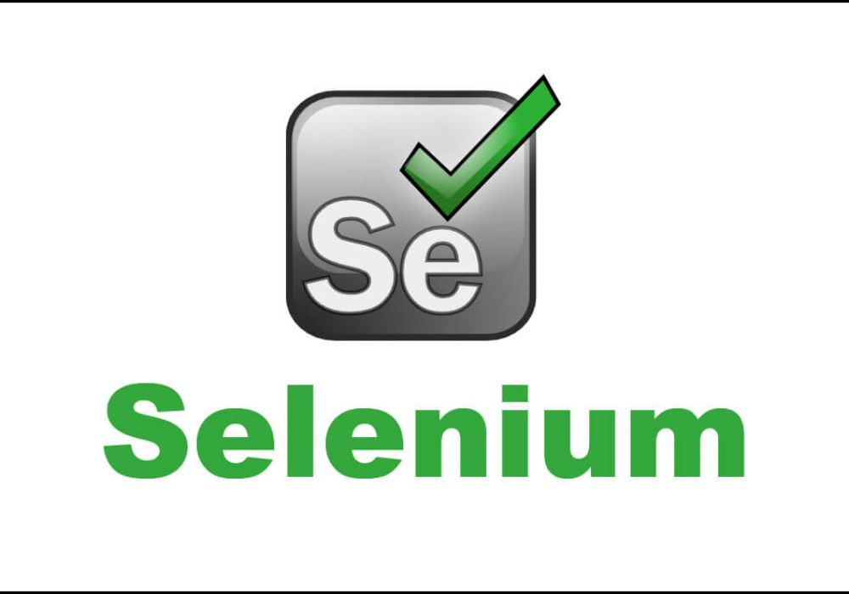



About the application
Application: MakeMyTrip.com
Description:
Automation Exercise is a dynamic MakeMyTrip website and a leading online travel company in India that offers a wide range of services including flight bookings, hotel reservations, holiday packages, train and bus tickets, and more.
The platform is designed to simplify the travel planning process for users by providing a seamless and user-friendly experience.
Features: flight search, hotel search, hotel filter, holiday search, holiday filter.
Technologies: Selenium WebDriver, Cucumber, Rest Assured, Postman.
2024 - RPS Consulting all rights reserved

Slide 6
Task Completed
Manual Testing:
Conducted through validation of UI and core functionalities.
Explored edge cases and usability issues.
Documented test cases and outcomes.
Jira:
Managed test cases and defect tracking.
Documented and tracked resolution of issues.
Selenium BDD with Cucumber:
Implemented automated UI tests using Selenium WebDriver.
Developed BDD scenarios with Cucumber and Gherkin syntax for defining system behaviour.
API Testing:
Tested API endpoints using Postman and Rest Assured.
Conducted automated and security tests.
2024 - RPS Consulting all rights reserved

Slide 7
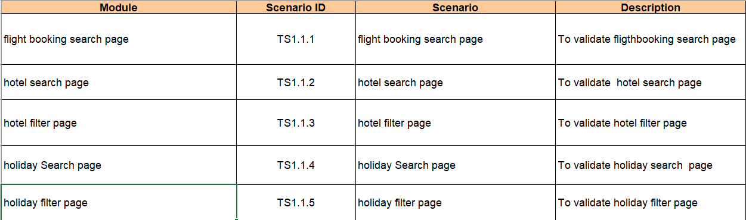
Manual Testing
Test Scenario Preparation:
Developed a comprehensive excel report detailing test scenarios including flight booking , hotel booking, filtering the hotels, holiday booking, filtering the packages. This documentation is ensured through coverage of critical functionalities.
2024 - RPS Consulting all rights reserved

Slide 8
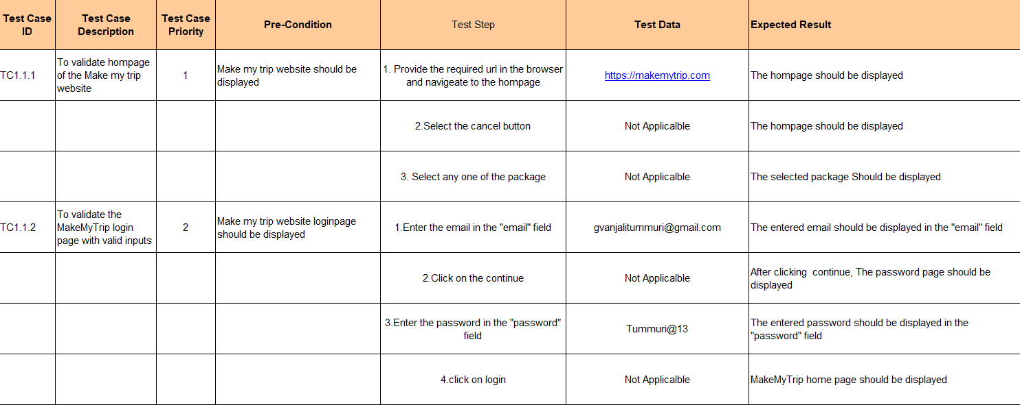
Manual Testing
Test Case Development:
Crafted detailed test cases outlining specific test steps, expected results, and actual outcomes. This structured approach allowed for systematic validation of each functionality, ensuring alignment with the application's requirements and performance standards.
2024 - RPS Consulting all rights reserved

Slide 9
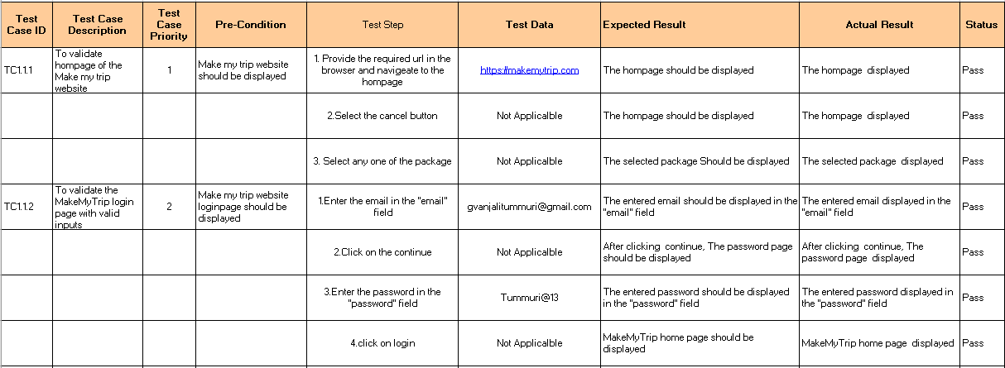
Manual Testing
Execution and Validation:
Executed the test cases to assess the application's functionality against the defined criteria. Performed exploratory testing to uncover edge cases and potential defects, enhancing the robustness of the application and ensuring a seamless user experience.
2024 - RPS Consulting all rights reserved

Slide 10
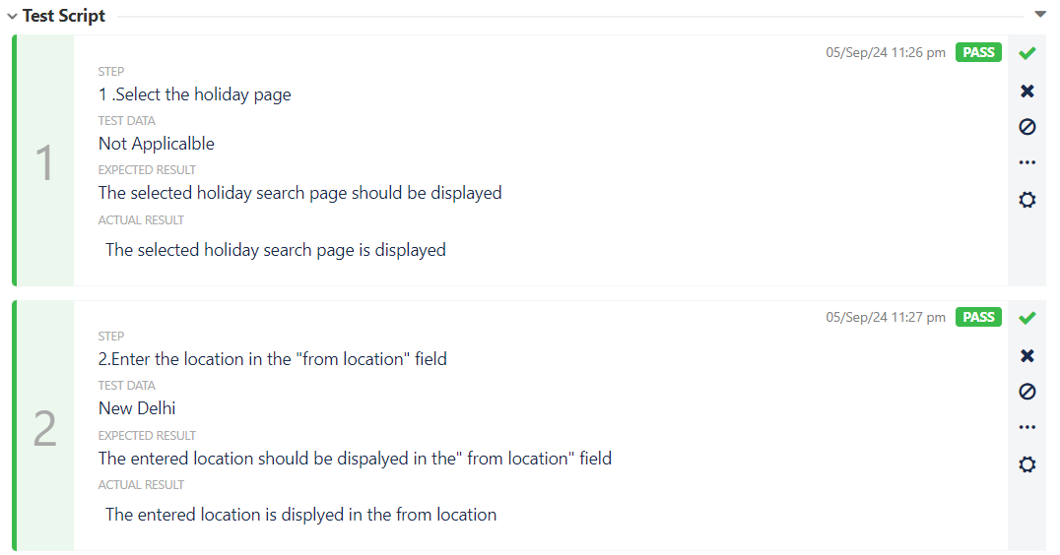
Jira
Defect Tracking and Management :
Utilized Jira as the primary tool for tracking defects and managing project workflows. Logged defects with detailed descriptions, including steps for reproduction, expected outcomes, and severity levels, ensuring accurate reporting . Imported my detailed Excel worksheet, which contained test cases and test steps, into a .csv file. Using Zephyr within Jira, I successfully imported the CSV, ensuring a smooth transition of test cases into the system for streamlined execution.
2024 - RPS Consulting all rights reserved

Slide 11
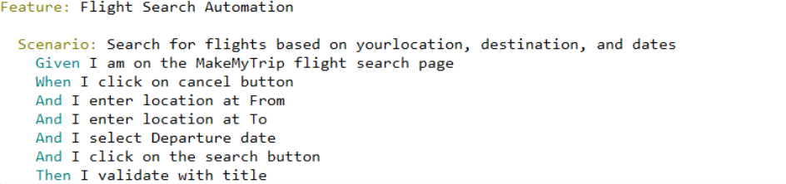
Selenium BDD with Cucumber
Automation Framework Development:
Built an automation framework using Selenium WebDriver integrated with BDD Cucumber, following the Page Object Model to ensure code reusability and maintainability across test scripts. The framework was designed with simplicity, allowing for easy updates and scalability as the project grows.
Scenario Creation:
Created feature field for scenarios such as booking for flight, hotel, and holiday packages. Each scenario was designed to simulate real user journeys, ensuring that the application performed as expected under various conditions.
2024 - RPS Consulting all rights reserved

Slide 12
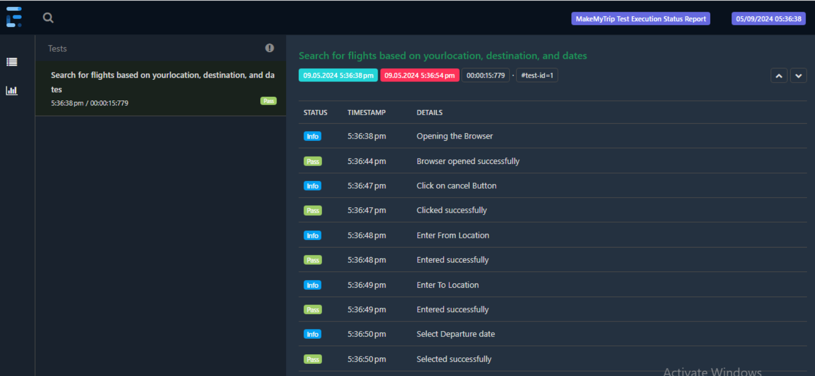
Selenium BDD with Cucumber
Integration with Extend Report:
Integrated Extent Reports to generate detailed reports of the test execution. These reports provided insights Into test results, logs, screenshots, and execution times, aiding in clear communication of outcomes to stakeholders.
2024 - RPS Consulting all rights reserved

Slide 13
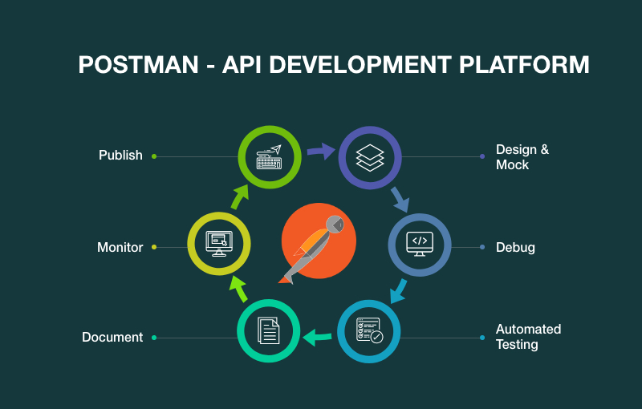
API Testing for Jsonplaceholder
API testing is a type of software testing that involves testing application programming interfaces directly and as part of integration testing to determine if they meet expectations for functionality, reliability, performance and security.
Tools: Postman, Rest Assured.
Purpose: Validate API responses and behaviour using JSONPlaceholder for learning and prototyping.
Requests:
GET: Retrieve posts.
POST: Create a new post.
PUT: Update a post.
DELETE: Remove a post.
Best Practices:
Validation: Ensure correct status codes and response structures.
Automation: Use automation scripts to run tests consistently.
Report issues: Document bugs found during testing for further analysis.
Documentation: Maintain clear records of test cases and outcomes.
2024 - RPS Consulting all rights reserved

Slide 14
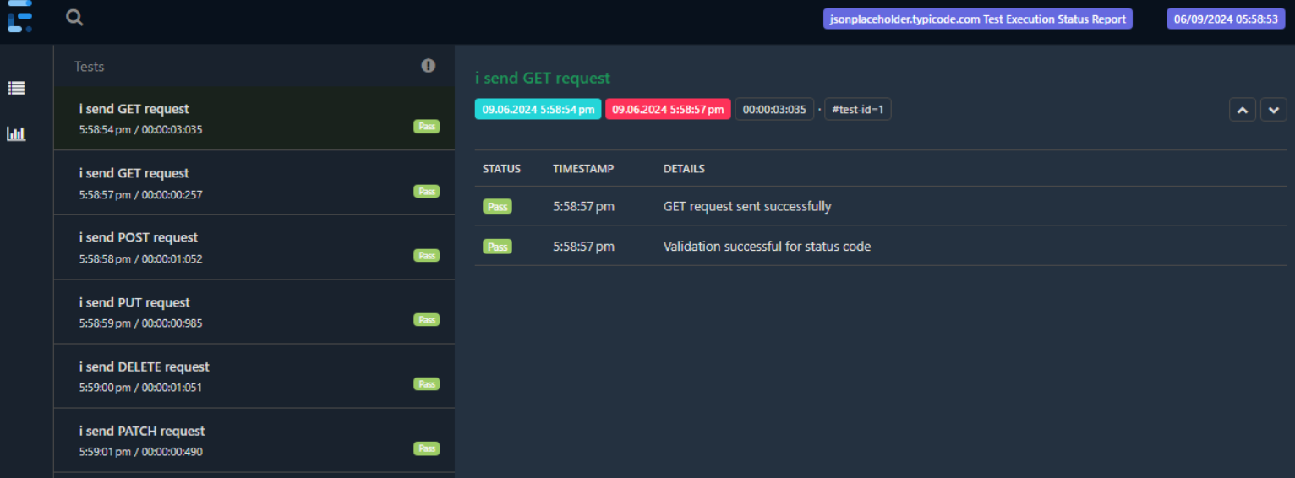
API Testing
Extent Reports Integration:
Integrated Extent Reports to generate detailed reports for API test execution. The reports included logs, pass/fail status, and any errors, which provided valuable insights.
2024 - RPS Consulting all rights reserved

Slide 15
Approach
Manual Testing:
Created detailed test cases in Excel with test scenarios, test steps, expected results, and actual results.
Imported detailed test case report into the JIRA by converting excel into csv
Using Zephyr manually tested the test cases by following test steps and test data, and raised the bugs in JIRA If they fail.
Automation Testing:
Create page File for each scenario like booking for flight, hotels and holiday packages and filters for hotels and holiday packages in that created methods for each test step.
Created feature file for each scenario using gherkin keywords and generated step definitions files for each scenario, created the object of the page by importing methods in step definition.
Integrated extent report for each step scenario whether pass or fail.
2024 - RPS Consulting all rights reserved

Slide 16
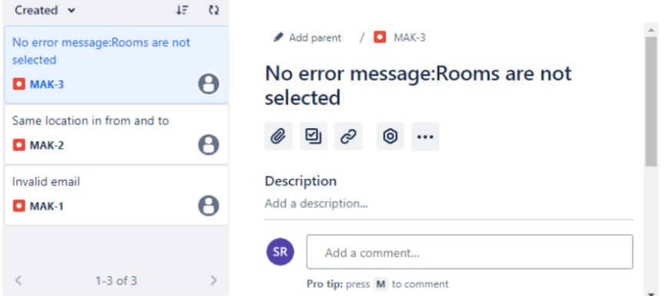
Defects found
Bug Reporting : Identified defects during testing and raised bugs directly in Jira, providing detailed descriptions, reproduction steps, and severity levels. This allowed for effective tracking and resolution of issues by the development team.
2024 - RPS Consulting all rights reserved

Slide 17
Challenges and Overcome
Handling User Interactions:
Challenge: Simulating user interactions (like clicks or text input) might not always work as expected due to timing issues or pop-ups.
Overcome: Implement explicit waits to ensure elements are interactable before performing actions. Use actions libraries (like Selenium’s Actions class) for complex interactions.
Error Handling and Validation:
Challenge: Error messages or validation feedback might not be consistent or visible.
Overcome: Validate error handling by deliberately entering incorrect data and verify the presence and correctness of error messages.
2024 - RPS Consulting all rights reserved

Slide 18
Conclusion
This training provided me with hand on experience in manual Testing and Automation testing, preparing me for real-world Challenges
The comprehensive testing approach has led to a more reliable and user-friendly experience for both the MakeMyTrip platform and the Json Place Holder API. By identifying and resolving issues early, the project has contributed to improved functionality, performance, and user satisfaction.
The project has successfully demonstrated the importance of thorough testing in delivering a high-quality user experience and reliable system performance. The solutions implemented have addressed critical issues, paving the way for a robust and efficient platform.
2024 - RPS Consulting all rights reserved

Slide 19
Thank You
2024 - RPS Consulting all rights reserved

